Slide 1
Slick
The Structured Way
Notes:
Build queries as if you would use Scala collections.
More lightweight than Hibernate

Slide 2

YENNICK? YANNICK? JANNICK?
Reactive Applications Consultant
Certified Typesafe “Fast Track to Scala” trainer
@SlevinBE
yennicktrevels.com
Yennick.Trevels@xploregroup.be

Slide 3
WHY SLICK?
Option(Anorm).orElse(Hibernate).orElse(Slick)
➔Pure Scala
➔Immutable data structures
➔DB agnostic code
➔Type safety

Slide 4

TALK MOTIVATION

Slide 5
MEAT OF THE TALK

Slide 6
ESSENTIALS
Build queries with Scala
Lifted embedding
Query result → result rows
ID | TITLE | ID | FIRSTNAME | LASTNAME
1 | “Scala” | 10 | Yennick | Trevels
1 | “Scala” | 11 | Eric | Loots
2 | “Slick” | 12 | Filip | Maelbrancke
Notes:
Slick doesn’t use standard Scala types, but lifts them into a Rep type constructor

Slide 7
IMPORTS
Database specific
Database agnostic import ➔ use Play-Slick plugin
Notes:
Import scala.slick.driver.H2Driver.simple._

Slide 8
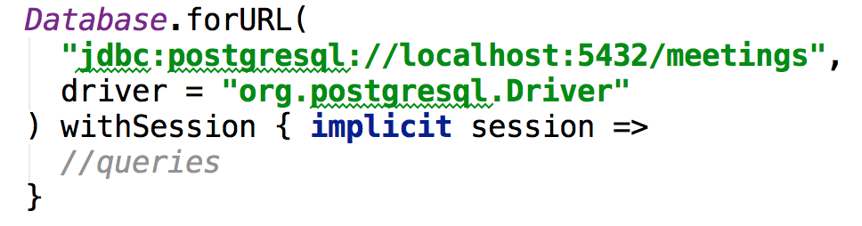
SESSION SCOPE
Notes:
Database.forURL(
"jdbc:postgresql://localhost:5432/meetings",
driver = "org.postgresql.Driver"
) withSession { implicit session =>
//queries
}

Slide 9
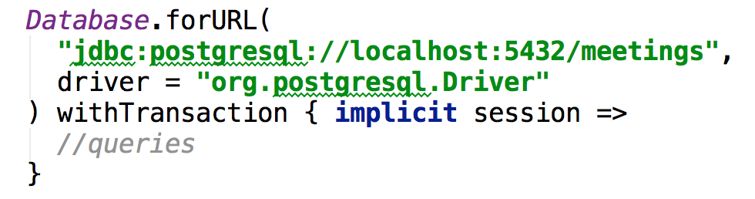
TRANSACTION SCOPE
Notes:
Database.forURL(
"jdbc:postgresql://localhost:5432/meetings",
driver = "org.postgresql.Driver"
) withTransaction { implicit session =>
//queries

Slide 10
SAMPLE DATABASE
MEETING
ID | …
DOCUMENT
ATTENDEE_LINK
ID | … | MEETING_ID
ID | … | MEETING_ID | ATTENDEE_ID
ATTENDEE
ID | …

Slide 11

LEVEL 1: MAPPING TABLES

Slide 12
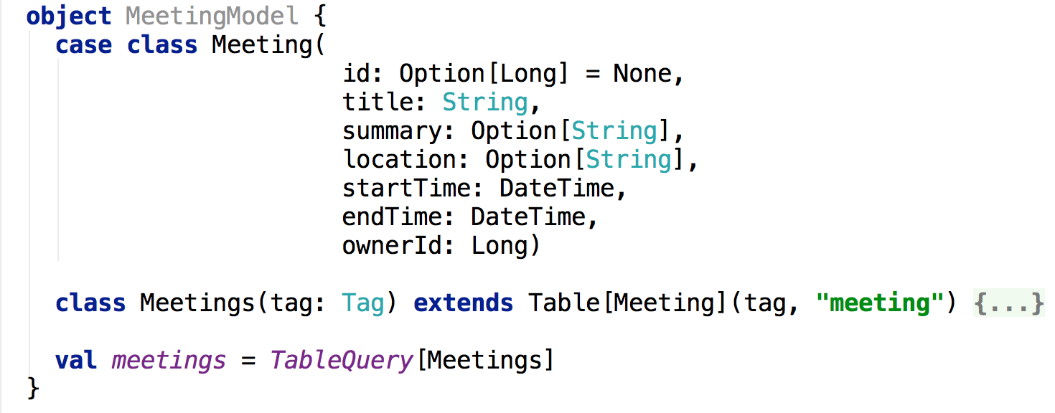

TABLE MAPPING: MEETING
Notes:
object MeetingModel {
case class Meeting(
id: Option[Long] = None,
title: String,
summary: Option[String],
location: Option[String],
startTime: DateTime,
endTime: DateTime,
ownerId: Long)
class Meetings(tag: Tag) extends Table[Meeting](tag, "meeting") {
def id = column[Long]("id", O.PrimaryKey, O.AutoInc)
def title = column[String]("title")
def summary = column[Option[String]]("summary")
def location = column[Option[String]]("location")
def startTime = column[DateTime]("start_time")
def endTime = column[DateTime]("end_time")
def ownerId = column[Long]("owner_id")
def * = (id.?, title, summary, location, startTime, endTime, ownerId) <> (Meeting.tupled, Meeting.unapply)
}
val meetings = TableQuery[Meetings]
}

Slide 13
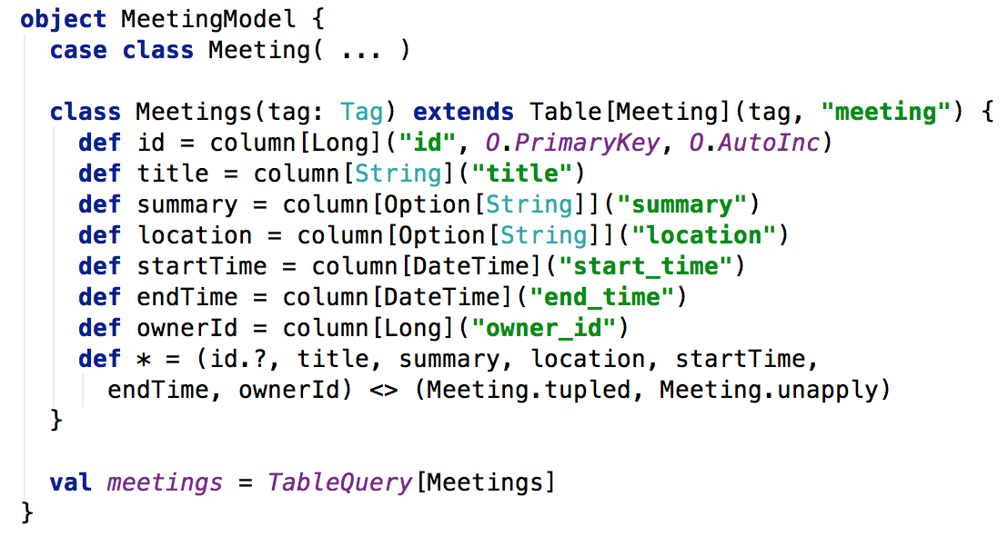
TABLE MAPPING: MEETING
Notes:
object MeetingModel {
case class Meeting(
id: Option[Long] = None,
title: String,
summary: Option[String],
location: Option[String],
startTime: DateTime,
endTime: DateTime,
ownerId: Long)
class Meetings(tag: Tag) extends Table[Meeting](tag, "meeting") {
def id = column[Long]("id", O.PrimaryKey, O.AutoInc)
def title = column[String]("title")
def summary = column[Option[String]]("summary")
def location = column[Option[String]]("location")
def startTime = column[DateTime]("start_time")
def endTime = column[DateTime]("end_time")
def ownerId = column[Long]("owner_id")
def * = (id.?, title, summary, location, startTime, endTime, ownerId) <> (Meeting.tupled, Meeting.unapply)
}
val meetings = TableQuery[Meetings]
}

Slide 14
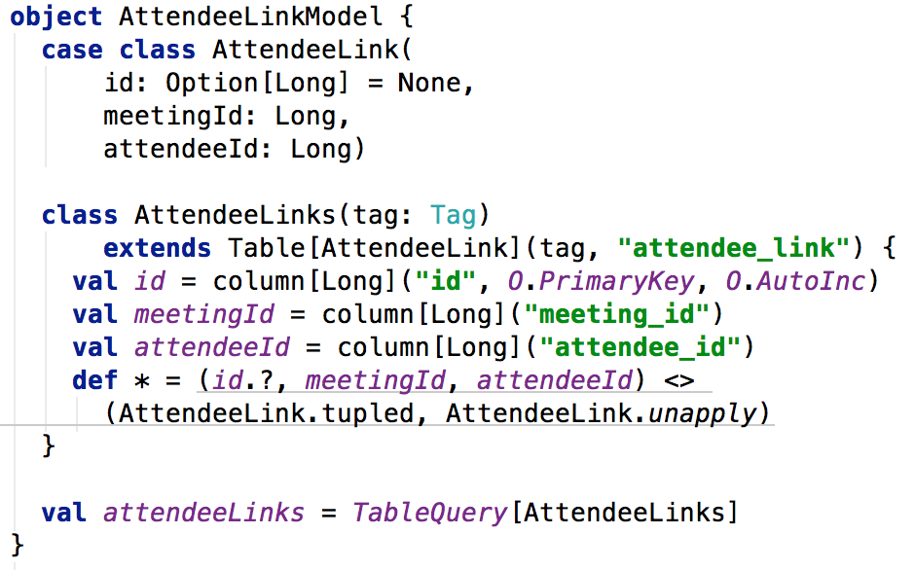
TABLE MAPPING: LINK TABLE
Notes:
object AttendeeLinkModel {
case class AttendeeLink(
id: Option[Long] = None,
meetingId: Long,
attendeeId: Long)
class AttendeeLinks(tag: Tag)
extends Table[AttendeeLink](tag, "attendee_link") {
val id = column[Long]("id", O.PrimaryKey, O.AutoInc)
val meetingId = column[Long]("meeting_id")
val attendeeId = column[Long]("attendee_id")
def * = (id.?, meetingId, attendeeId) <>
(AttendeeLink.tupled, AttendeeLink.unapply)
}
val attendeeLinks = TableQuery[AttendeeLinks]
}

Slide 15

LEVEL 2: BASIC QUERIES

Slide 16

FILTER STATEMENTS
Slick
SQL
➔ === instead of ==
Notes:
Slick
meetings.filter(_.ownerId === 1L).list
SQL
Select * from meeting where owner_id = 1

Slide 17
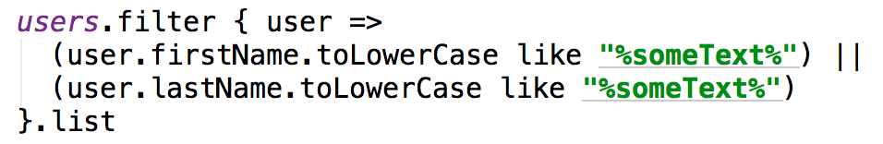
FILTER STATEMENTS
Slick
➔Brackets
➔Put || or && at end of line
↵
Notes:
Slick
users.filter { user =>
(user.firstName.toLowerCase like "%someText%") ||
(user.lastName.toLowerCase like "%someText%") ↵
}.list

Slide 18
SORTING
Slick
SQL
Notes:
Slick
meetings.sortBy(_.startTime.desc).list
SQL
select * from meeting order by meeting.start_time desc

Slide 19
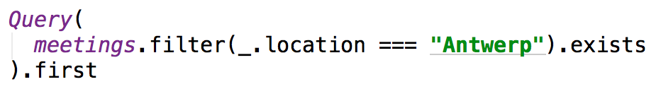
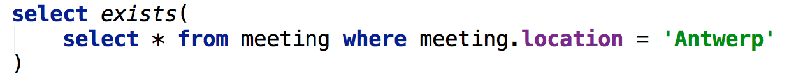
EXISTS
Slick
SQL
Notes:
Aggregate function exists returns a scalar function (a non-record, non-collection value represented by type Column[T]). Therefore aggregate functions have to be wrapped in a Query() statement.
Slick
Query(
meetings.filter(_.location === "Antwerp").exists
).first
SQL
select exists(
select * from meeting where meeting.location = 'Antwerp'
)

Slide 20
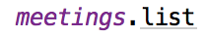

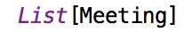
DEFINING THE RESULT
Slick
SQL
Result
Notes:
Slick
meetings.list
SQL
select * from meeting
Result
List[Meeting]

Slide 21
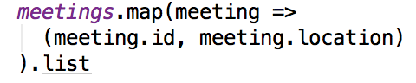
DEFINING THE RESULT
Slick
SQL
Result
Notes:
Slick
meetings.map(meeting =>
(meeting.id, meeting.location)
).list
SQL
select id, location from meetings
Result
List[(Long, Option[String])]

Slide 22
DEFINING THE RESULT
Slick
meetings.list ➔ List[Meeting]
meetings.first ➔ Meeting or NoSuchElementException
meetings.firstOption ➔ Option[Meeting]

Slide 23

LEVEL 3: ADVANCED QUERIES

Slide 24
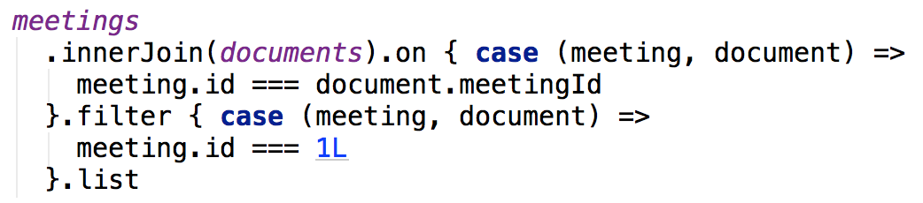
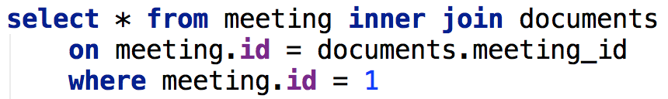
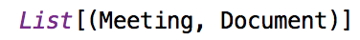

INNER JOIN
Slick
SQL
Result
Notes:
Slick
meetings
.innerJoin(documents).on { case (meeting, document) =>
meeting.id === document.meetingId
}.filter { case (meeting, document) =>
meeting.id === 1L
}.list
Result
List[(Meeting, Document)]

Slide 25
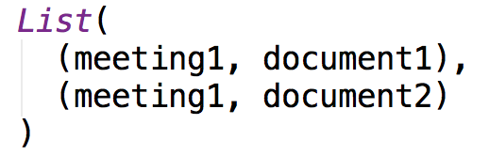
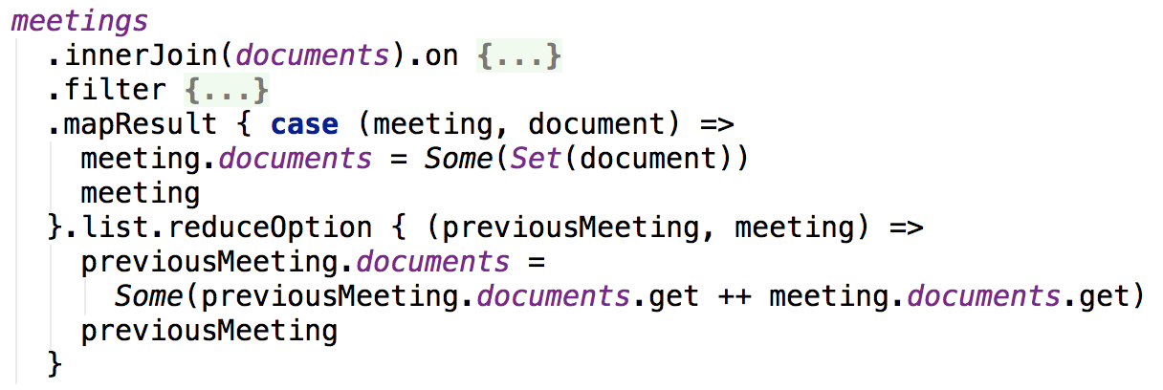
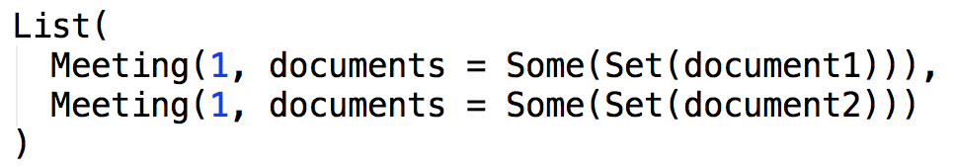
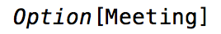
INNER JOIN (RESULT MAPPING)
Slick
Result
Notes:
Slick
meetings
.innerJoin(documents).on { case (meeting, document) =>
meeting.id === document.meetingId
}
.filter { case (meeting, document) =>
meeting.id === 1L
}
.mapResult { case (meeting, document) =>
meeting.documents = Some(Set(document))
meeting
}.list.reduceOption { (previousMeeting, meeting) =>
previousMeeting.documents =
Some(previousMeeting.documents.get ++ meeting.documents.get)
previousMeeting
}

Slide 26
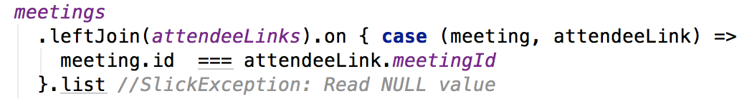
OUTER JOINS (THE PROBLEM)
Slick
Notes:
Slick
meetings
.leftJoin(attendeeLinks).on { case (meeting, attendeeLink) =>
meeting.id === attendeeLink.meetingId
}.list //SlickException: Read NULL value

Slide 27
OUTER JOINS (THE PROBLEM)
ID | TITLE | ID | MEETING_ID | ATTENDEE_ID
1 | “Scala” | NULL | NULL | NULL
2 | “Slick” | 10 | 2 | 20
3 | “Slick” | 11 | 2 | 21
Left Join
ID | TITLE
1 | “Scala”
2 | “Slick”
ID | MEETING_ID | ATTENDEE_ID
10 | 2 | 20
11 | 2 | 21
Ref: http://www.slideshare.net/skillsmatter/patterns-for-slick-database-applications

Slide 28
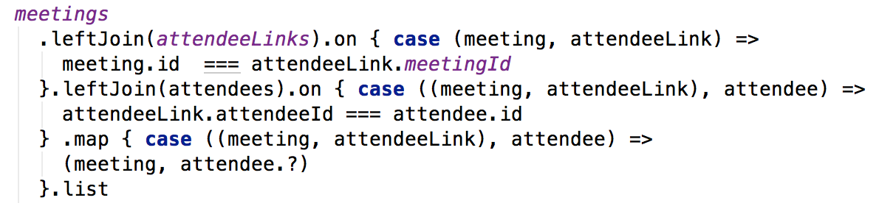
OUTER JOINS
Slick
Result
Notes:
meetings
.leftJoin(attendeeLinks).on { case (meeting, attendeeLink) =>
meeting.id === attendeeLink.meetingId
}.leftJoin(attendees).on { case ((meeting, attendeeLink), attendee) =>
attendeeLink.attendeeId === attendee.id
} .map { case ((meeting, attendeeLink), attendee) =>
(meeting, attendee.?)
}.list

Slide 29
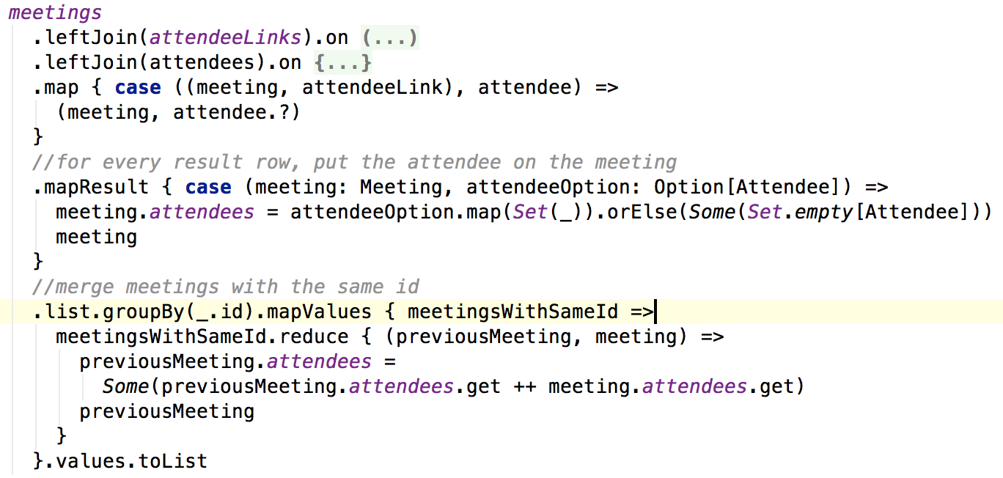
OUTER JOINS (RESULT TRANSF.)
Slick
Notes:
meetings
.leftJoin(attendeeLinks).on { …}
.leftJoin(attendees).on { … }
.map { case ((meeting, attendeeLink), attendee) =>
(meeting, attendee.?)
}
//for every result row, put the attendee on the meeting
.mapResult { case (meeting: Meeting, attendeeOption: Option[Attendee]) =>
meeting.attendees = attendeeOption.map(Set(_)).orElse(Some(Set.empty[Attendee]))
meeting
}
//merge meetings with the same id
.list.groupBy(_.id).mapValues { meetingsWithSameId =>
meetingsWithSameId.reduce { (previousMeeting, meeting) =>
previousMeeting.attendees = Some(previousMeeting.attendees.get ++ meeting.attendees.get)
previousMeeting
}
}.values.toList

Slide 30
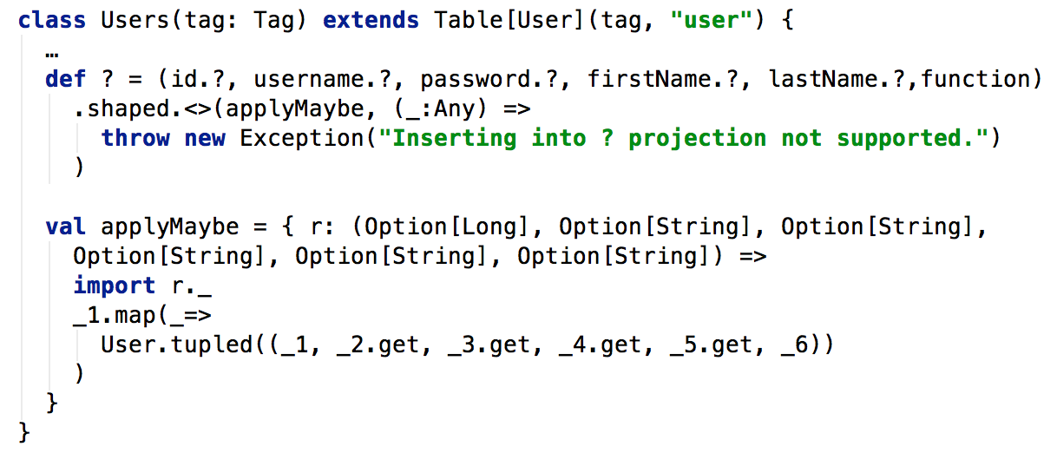

THE ? FUNCTION
Solution expected somewhere this year
Notes:
The ? function is currently required to make optional result rows work in outer joins. This is something you have to manually implement, or let it generate by the Slick code generator. This is expected to be fixed somewhere this year.
class Users(tag: Tag) extends Table[User](tag, "user") {
…
def ? = (id.?, username.?, password.?, firstName.?, lastName.?,function)
.shaped.<>(applyMaybe, (_:Any) =>
throw new Exception("Inserting into ? projection not supported.")
)
val applyMaybe = { r: (Option[Long], Option[String], Option[String],
Option[String], Option[String], Option[String]) =>
import r._
_1.map(_=>
User.tupled((_1, _2.get, _3.get, _4.get, _5.get, _6))
)
}
}

Slide 31

LEVEL 4: INSERT/UPDATE/DELETE

Slide 32

INSERT
Slick
SQL
Notes:
Slick
meetings.returning(meetings.map(_.id)).insert(meeting)
SQL
INSERT INTO "meeting"
("title",”summary","location","start_time","end_time","owner_id")
VALUES (?,?,?,?,?,?), returning: id

Slide 33
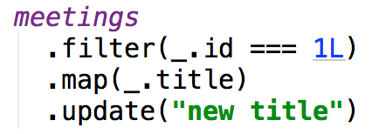
UPDATE
Slick
SQL
Notes:
Slick
meetings
.filter(_.id === 1L)
.map(_.title)
.update(“new title”)
SQL
update meeting set title = ‘new title’ where meeting.id = 1

Slide 34
DELETE
Slick
SQL
Notes:
Slick
meetings.filter(_.id === 1L).delete
SQL
delete from meeting where meeting.id = 1

Slide 35

LEVEL 5: SLICK + PLAY

Slide 36
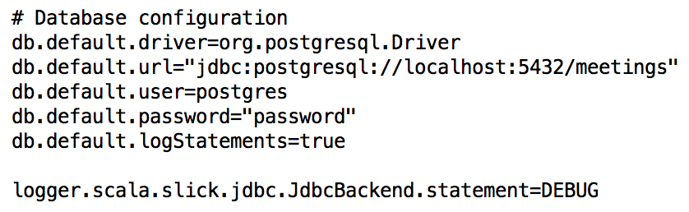

APPLICATION.CONF
Notes:
# Database configuration
db.default.driver=org.postgresql.Driver
db.default.url="jdbc:postgresql://localhost:5432/meetings"
db.default.user=postgres
db.default.password="password"
db.default.logStatements=true
logger.scala.slick.jdbc.JdbcBackend.statement=DEBUG

Slide 37
DATABASE AGNOSTIC IMPORTS
Notes:
import play.api.db.slick.Config.driver.simple._

Slide 38
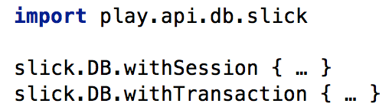
DB WRAPPER
Notes:
import play.api.db.slick
slick.DB.withSession { … }
slick.DB.withTransaction { … }

Slide 39
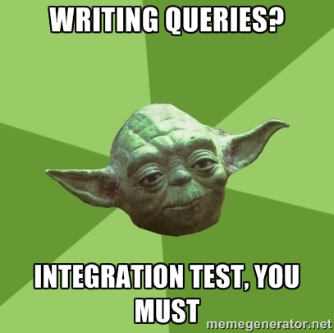
LEVEL 6: INTEGRATION TESTING

Slide 40
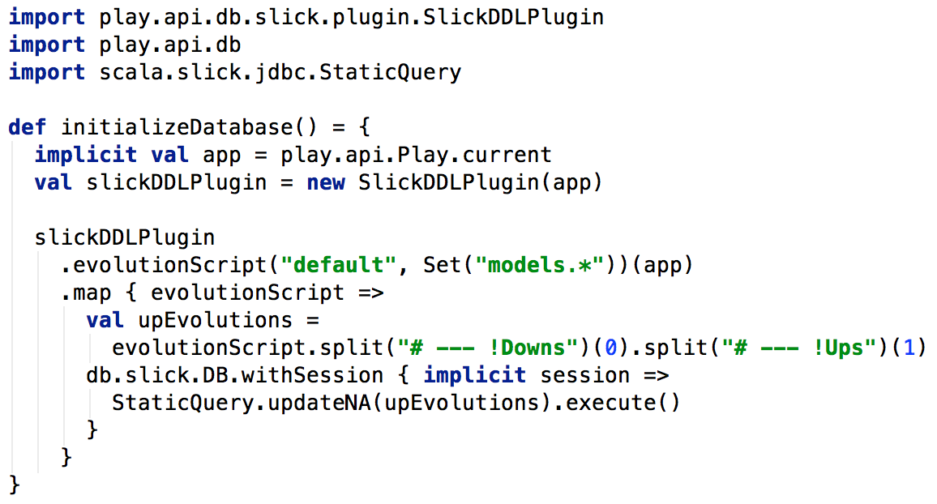

TABLE CREATION
Using Play-Slick plugin classes
Notes:
This will create all the tabels based on your mapped models. For this it uses the Play-Slick plugin classes which can generate an evolution script for us, from which we can then extract the create statements.
import play.api.db.slick.plugin.SlickDDLPlugin
import play.api.db
import scala.slick.jdbc.StaticQuery
def initializeDatabase() = {
implicit val app = play.api.Play.current
val slickDDLPlugin = new SlickDDLPlugin(app)
slickDDLPlugin
.evolutionScript("default", Set("models.*"))(app).map { evolutionScript =>
val upEvolutions = evolutionScript.split("# --- !Downs")(0).split("# --- !Ups")(1)
db.slick.DB.withSession { implicit session =>
StaticQuery.updateNA(upEvolutions).execute()
}
}
}

Slide 41
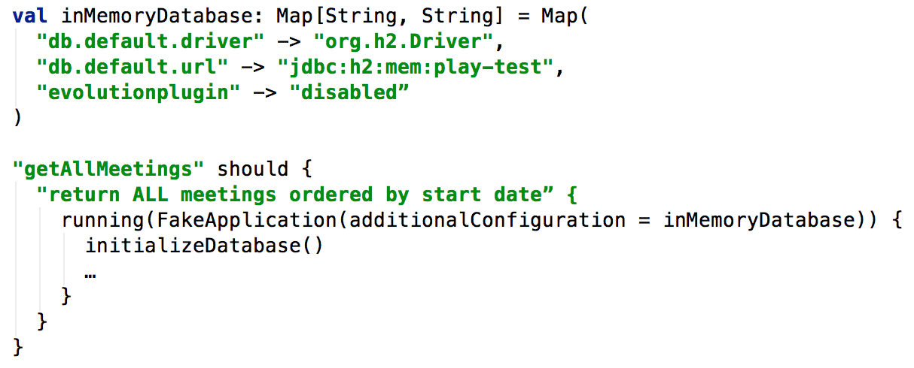
IN-MEMORY DATABASE CONFIG
Notes:
val inMemoryDatabase: Map[String, String] = Map(
"db.default.driver" -> "org.h2.Driver",
"db.default.url" -> "jdbc:h2:mem:play-test",
"evolutionplugin" -> "disabled”
)
"getAllMeetings" should {
"return ALL meetings ordered by start date” {
running(FakeApplication(additionalConfiguration = inMemoryDatabase)) {
initializeDatabase()
…
}
}
}

Slide 42
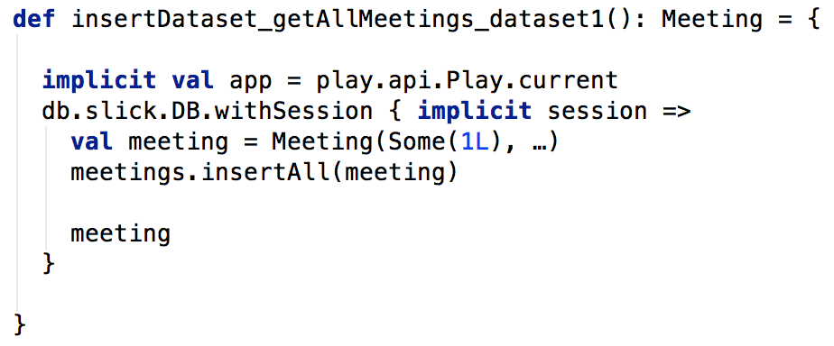
TEST DATA SETUP
Just use Slick…
Notes:
def insertDataset_getAllMeetings_dataset1(): Meeting = {
implicit val app = play.api.Play.current
db.slick.DB.withSession { implicit session =>
val meeting = Meeting(Some(1L), …)
meetings.insertAll(meeting)
meeting
}
}

Slide 43
CONCLUSION

Slide 44
THOUGHTS ON SLICK
+ Lightweight
+ Level of control
+ Production ready
Documentation
Generated Queries (readability)

Slide 45
CONTACT US
Development
Coaching
Training
Hello Scala seminar June 25th 2014
Fast Track to Scala October 09th 2014
Fast Track to Akka with Scala November 04th 2014
Yennick.Trevels@xploregroup.be

